Slide 1
MSCBIO/CMPBIO 2065 Logistic Matrix Factorization for Drug-Target Interaction Prediction on STITCH database
Fen Pei Chi Zhang
Dec 16, 2016

Slide 2
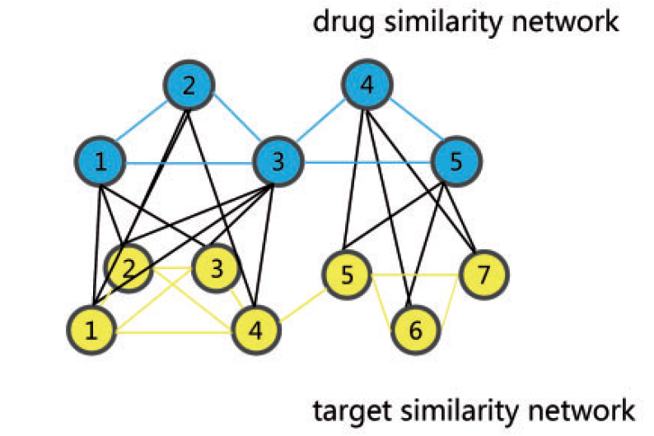
Recent computational methods on Drug-Target Interaction (DTI) prediction
Network based methods
Chen, X., et al. (2012). Molecular BioSystems 8(7): 1970-1978.
Machine learning based methods

Slide 3
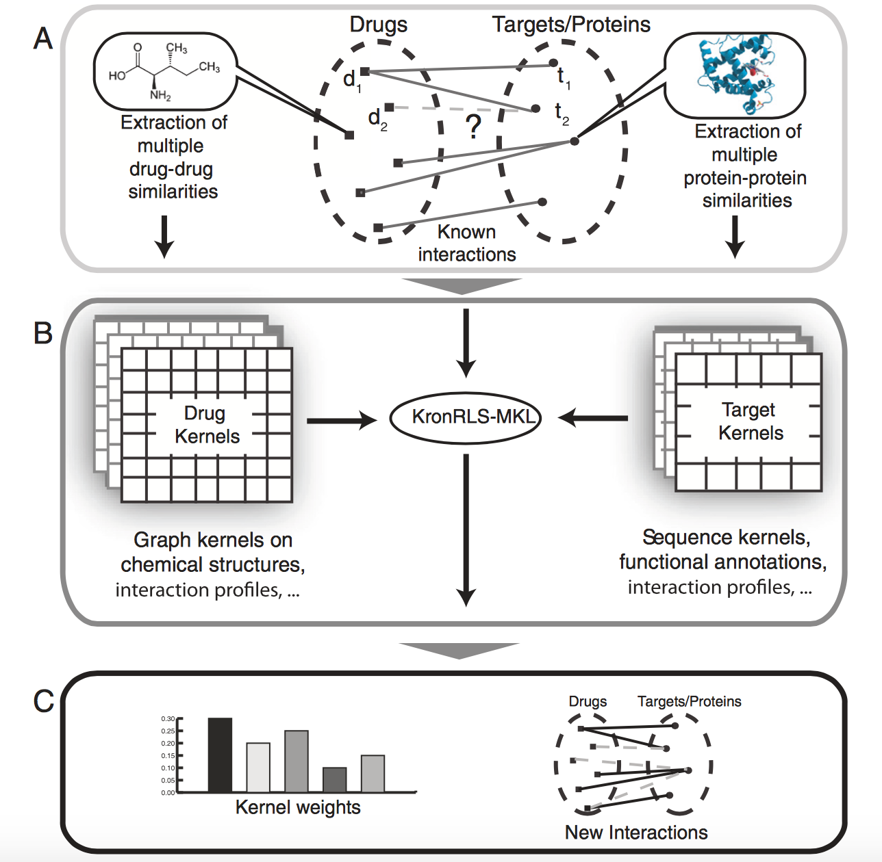
Machine learning based methods
Multiple kernel learning method
Nascimento, A. C., et al. (2016). BMC Bioinformatics 17: 46.

Slide 4
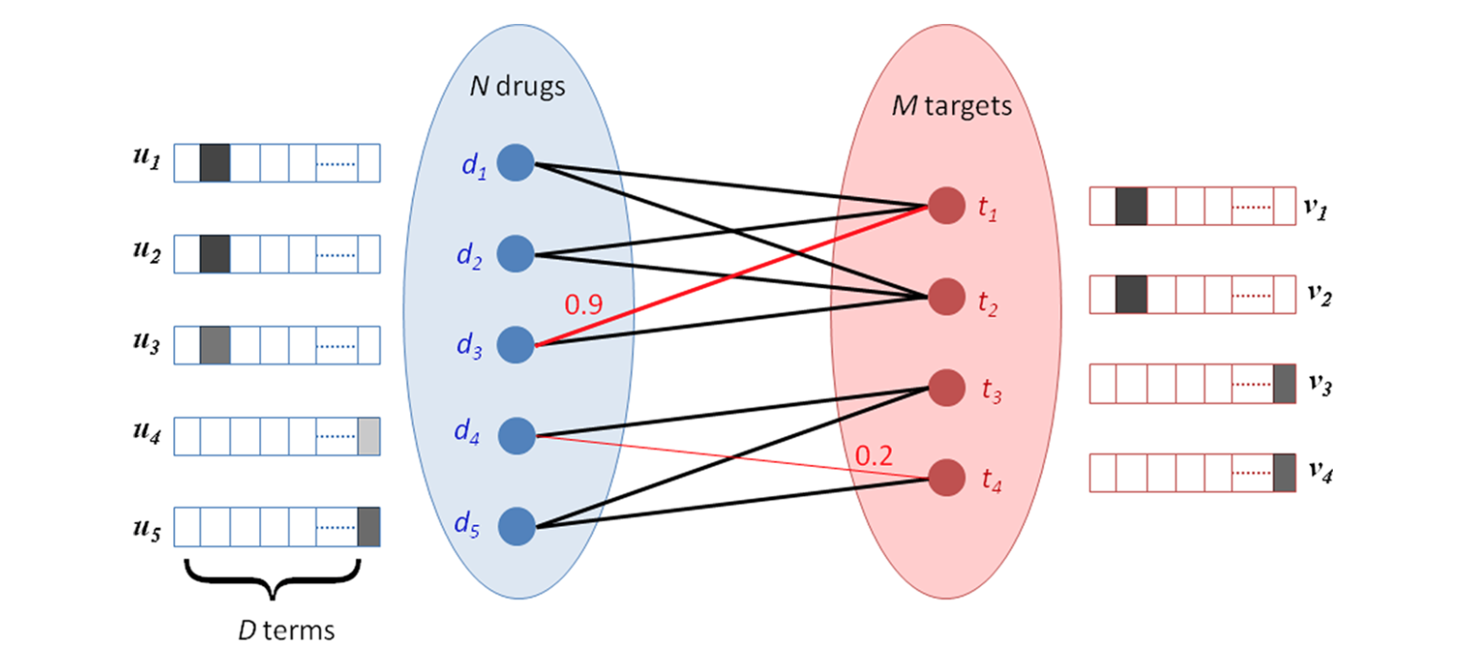
Machine learning based methods
Matrix Factorization method
predict weights on missing edges based on the existing nodes and edges in the network
Cobanoglu, M. C., et al. (2013). J Chem Inf Model. 53(12): 3399-3409.

Slide 5
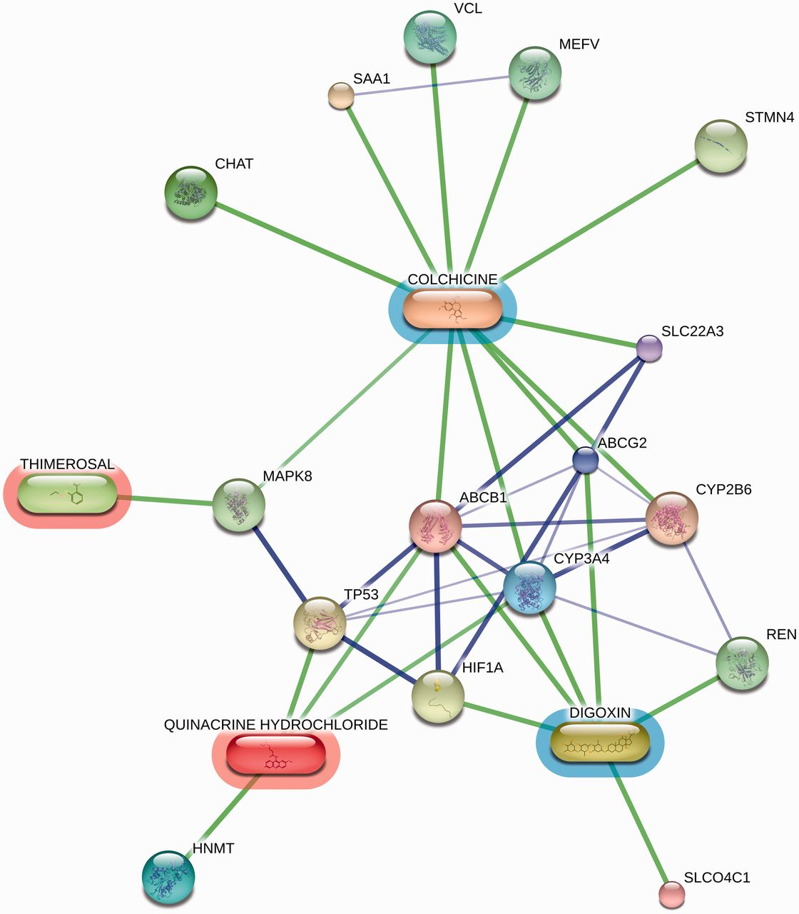
STITCH database
Integrated database with known and predicted chemical–protein interactions
Version 4 (2014), human experimental sub data set
531,716 chemicals (including different stereoisomer)
9,337 proteins
1,351,208 chemical-protein interactions
experimental confidence score: converted from reported affinities like residual kinase activities and kinase affinities, low (< 0.5), medium (0.5-0.7) and high confidence (> 0.7)
Michael Kuhn et al. Nucl. Acids Res. 2014;42:D401-D407

Slide 6
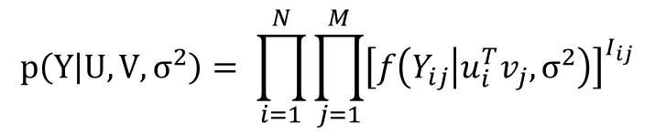
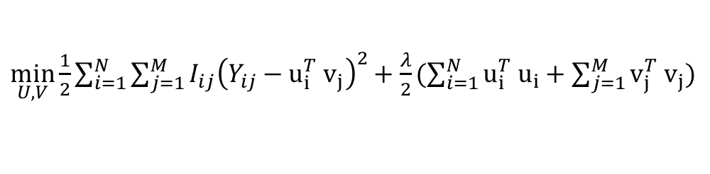
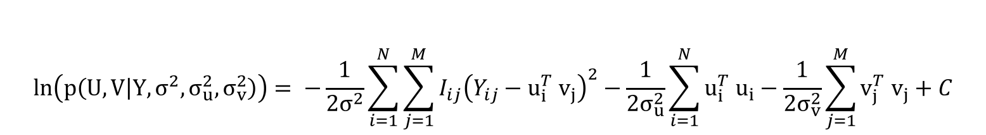

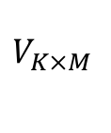

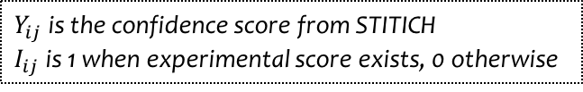
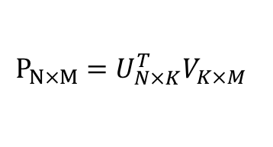
Baseline method: Probabilistic Matrix Factorization (PMF)
$$V_{K×M }$$
$$U_{N×K}$$
$$P_{N×M}=U_{N×K}^{T}V_{K×M }$$
$$P_{N×M}$$
$$p\left(Y | U,V,σ^{2}\right)= \prod_{i=1}^{N}{\prod_{j=1}^{M}{{\left[f\left(Y_{ij} | u_{i}^{T}v_{j}, σ^{2}\right)\right]}^{I_{ij}}}}$$
$Y_{ij}$ is the confidence score from STITICH
$I_{ij}$ is 1 when experimental score exists, 0 otherwise
$$\ln\left(p\left(U,V | Y, σ^{2},σ_{u}^{2}, σ_{v}^{2}\right)\right)= −\frac{1}{2σ^{2}}\sum_{i=1}^{N}{\sum_{j=1}^{M}{I_{ij}{\left(Y_{ij}−u_{i}^{T} v_{j}\right)}^{2}−\frac{1}{2σ_{u}^{2}}\sum_{i=1}^{N}{u_{i}^{T} u_{i}}}}−\frac{1}{2σ_{v}^{2}}\sum_{j=1}^{M}{v_{j}^{T} v_{j}}+C$$
$\min_{U,V}{\frac{1}{2}\sum_{i=1}^{N}{\sum_{j=1}^{M}{I_{ij}{\left(Y_{ij}−u_{i}^{T} v_{j}\right)}^{2}+\frac{λ}{2}(\sum_{i=1}^{N}{u_{i}^{T} u_{i}+\sum_{j=1}^{M}{v_{j}^{T} v_{j}})}}}}$
Cobanoglu, M. C., et al. (2013). J Chem Inf Model. 53(12): 3399-3409.

Slide 7
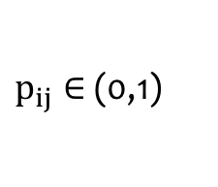
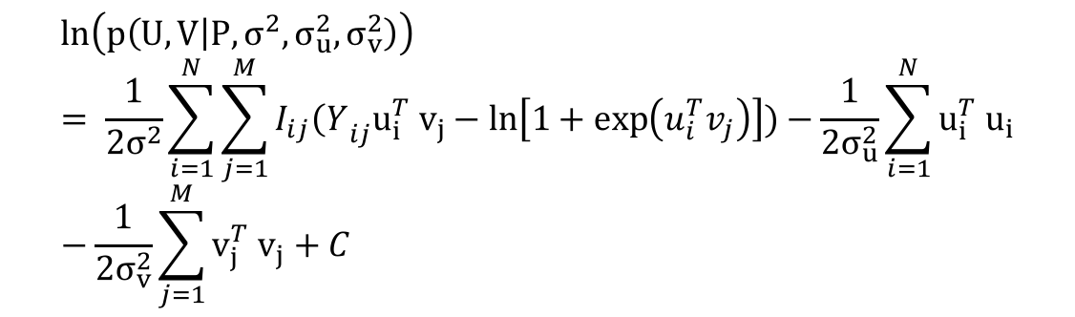
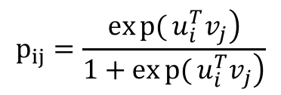
Logistic Matrix Factorization (LMF)
$$p_{ij}=\frac{\left.exp{(}u_{i}^{T}v_{j}\right)}{\left.1+exp{(}u_{i}^{T}v_{j}\right)}$$
$p_{ij}∈$(0,1)
$$\ln\left(p\left(U,V | P, σ^{2},σ_{u}^{2}, σ_{v}^{2}\right)\right)= \frac{1}{2σ^{2}}\sum_{i=1}^{N}{\sum_{j=1}^{M}{I_{ij}{\left(Y\right.}_{ij}u_{i}^{T} v_{j}−\ln\left[1+\exp\left(u_{i}^{T}v_{j}\right)\right])−\frac{1}{2σ_{u}^{2}}\sum_{i=1}^{N}{u_{i}^{T} u_{i}}}}−\frac{1}{2σ_{v}^{2}}\sum_{j=1}^{M}{v_{j}^{T} v_{j}}+C$$
$$\min_{U,V}{\frac{1}{2}\sum_{i=1}^{N}{\sum_{j=1}^{M}{I_{ij}(ln\left[1+\exp\left(u_{i}^{T}v_{j}\right)\right]−Y_{ij}u_{i}^{T} v_{j})+\frac{λ}{2}(\sum_{i=1}^{N}{u_{i}^{T} u_{i}+\sum_{j=1}^{M}{v_{j}^{T} v_{j}})}}}}$$
Liu, Y., et al. (2016). PLoS Comput Biol. 12(2): e1004760

Slide 8
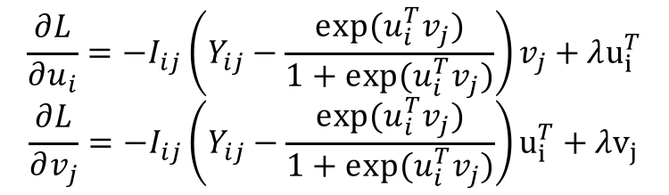
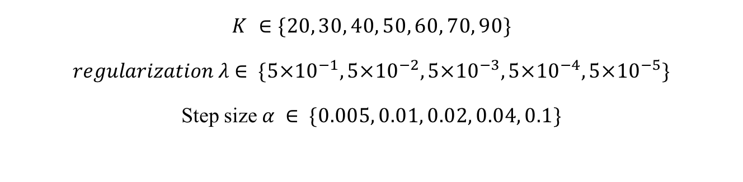
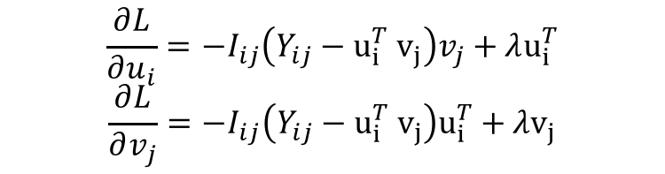
Gradient Descent
Gradient for PMF L2 loss:
Gradient for LMF L2 loss:
$$\frac{∂L}{∂u_{i}}=−I_{ij}\left(Y_{ij}−u_{i}^{T} v_{j}\right)v_{j}+λu_{i}^{T}$$
$$\frac{∂L}{∂v_{j}}=−I_{ij}\left(Y_{ij}−u_{i}^{T} v_{j}\right)u_{i}^{T}+λv_{j}$$
$$\frac{∂L}{∂u_{i}}=−I_{ij}\left(Y_{ij}−\frac{exp⁡(u_{i}^{T}v_{j})}{1+exp⁡(u_{i}^{T}v_{j})}\right)v_{j}+λu_{i}^{T}$$
$$\frac{∂L}{∂v_{j}}=−I_{ij}\left(Y_{ij}−\frac{exp⁡(u_{i}^{T}v_{j})}{1+exp⁡(u_{i}^{T}v_{j})}\right)u_{i}^{T}+λv_{j}$$
Parameter search:
$$K ∈\{20, 30, 40, 50, 60, 70, 90\}$$
$regularization λ$ $∈ \{5×{10}^{−1}, 5×{10}^{−2},5×{10}^{−3},5×{10}^{−4},5×{10}^{−5}\}$
Step size $α ∈ \{0.005, 0.01, 0.02, 0.04, 0.1\}$

Slide 9
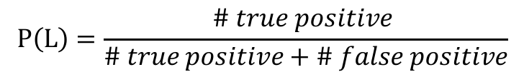
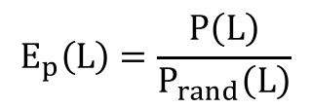
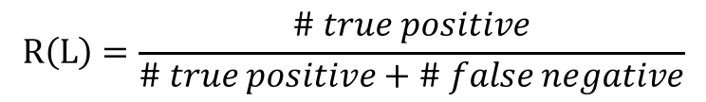
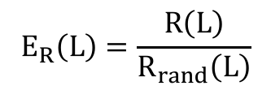
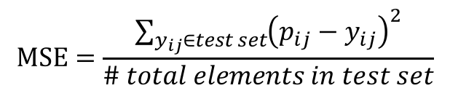
Performance evaluation: 10-fold cross-validation
$$MSE=\frac{\sum_{y_{ij}∈test set}{{\left(p_{ij}−y_{ij}\right)}^{2}}}{\# total elements in test set}$$
Mean Square Error:
Positive interaction cutoff: high confidence ( > 0.7, total number 35,629) high and median confidence (> 0.5, total number 64,665)
Precision & Precision Enrichment:
$$P\left(L\right)=\frac{\# true positive }{\# true positive+\# false positive}$$
$$E_{p}\left(L\right)=\frac{P\left(L\right)}{P_{rand}\left(L\right)}$$
Recall & Recall Enrichment:
$$R\left(L\right)=\frac{\# true positive}{\# true positive+\# false negative}$$
$$E_{R}\left(L\right)=\frac{R\left(L\right)}{R_{rand}\left(L\right)}$$

Slide 10
Results
 | PMF | LMF
MSE | 0.0436 ± 0.0015 | 0.0227 ± 0.0002
Precision (score >0.7) | 0.6228 ± 0.0036 | 0.6330 ± 0.0026
Precision Enrichment (score >0.7) | 2.7221 ± 0.0229 | 2.7776 ± 0.0202
Recall (score >0.7) | 0.6003 ± 0.0050 | 0.6319 ± 0.0018
Recall Enrichment (score >0.7) | 1.9954 ± 0.0198 | 2.1181 ± 0.0198
Precision (score >0.5) | 0.7752 ± 0.0037 | 0.7804 ± 0.0028
Precision Enrichment (score >0.5) | 1.8827 ± 0.0065 | 1.8946 ± 0.0074
Recall (score >0.5) | 0.8129 ± 0.0025 | 0.8159 ± 0.0023
Recall Enrichment (score >0.5) | 1.6283 ± 0.0092 | 1.6345± 0.0076

Slide 11
Future work
Try other regularization methods to get better performance
Evaluate performance base on different protein groups
Figure out other tools to run larger data set

